Slide 1

Web App Optimizations:
Let your application
get loaded blazing fast
PWA Oslo meetup
8th, Feb 2018
Majid Hajian

Slide 2
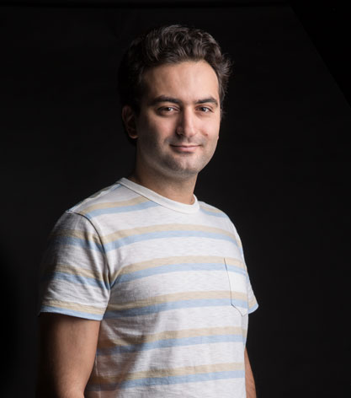
ABOUT ME
Passionate web developer
Open Source lover and contributor
Public speaker,
Organizer (Vue.js Oslo),
PacktPub Instructor
HNPWA Contributor
Majid Hajian
@mhadaily
https://glimmer-hn-pwa.firebaseapp.com

Slide 3


Glimmer
JS

Slide 4
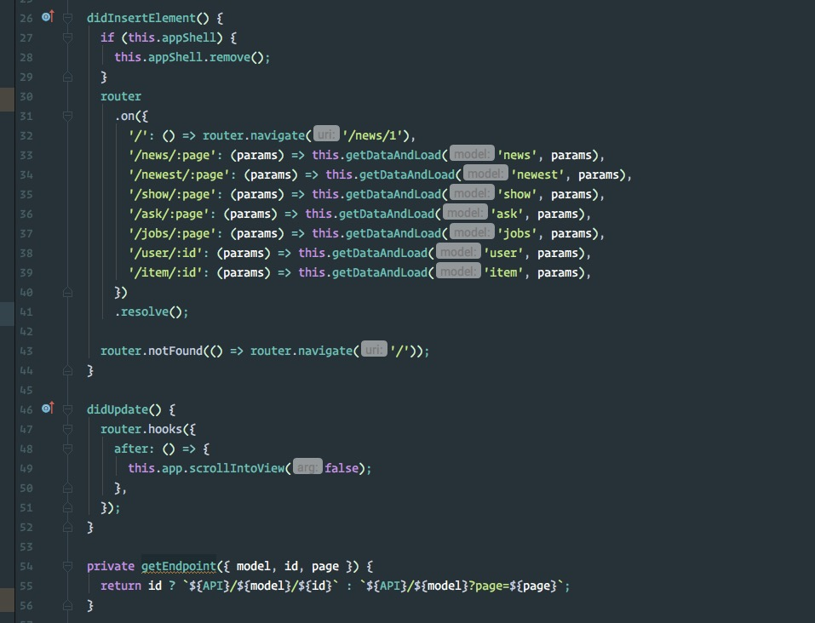
A fast and
lightweight
UI component
library
from
the Ember.js team

Slide 5

1.
CSS

Slide 6

Styling
CSS
01
Flexbox vs Grid
02
APP-SHELL
03
Critical CSS
04
Minify CSS

Slide 7
CODE
DEMO TIME

Slide 8

2.
Javascript

Slide 9
JAVSCRIPT
Optimization
01
Bundle / Uglyfying
02
Service Worker / different strategy
03
Minimal Library
04
Lazy Loading

Slide 10
CODE
DEMO TIME

Slide 11

3.
More…

Slide 12
MORE
Optimization
01
HTTP 2
02
HTTP2 Server Push
03
dns-prefetch
04
prefetch
05
preload
06
Server Side Rendering

Slide 13
CODE
DEMO TIME

Slide 14
THANK YOU
See You Next Time
MAJID HAJIAN
@mhadaily

